Slide 1
Control of Mobile Robots
Raspberry Pi Edition

Slide 2
Introduction
Robot Models: Two-wheel Differential Drive, Omni-drive
Computing Motor Control
Kinematics
Demonstration

Slide 3
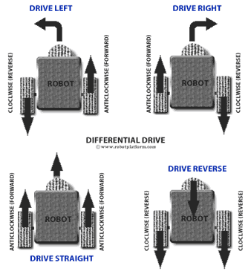
Robot Model 1 Two Wheel Differential Drive
Given information about robot
R -> radius of each wheel
L -> length of wheelbase
Inputs
v -> velocity
ω -> heading
Desired information:
Velocity of left wheel
Velocity of right wheel

Slide 4
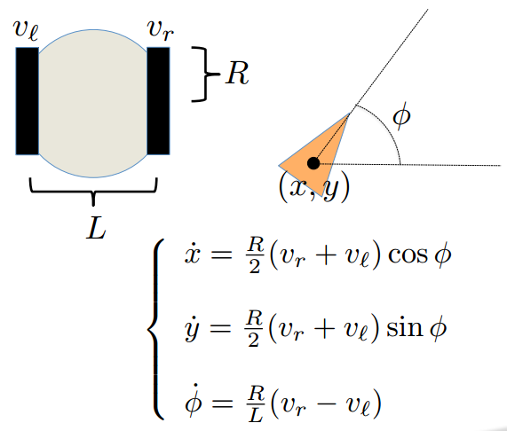
Robot Model 1 Two Wheel Differential Drive
Wheel Outputs:
v_{r} = (2v + ωL) / 2R
v_{l} = (2v - ωL) / 2R
Where is the robot now, based on the measurements of the wheels

Slide 5
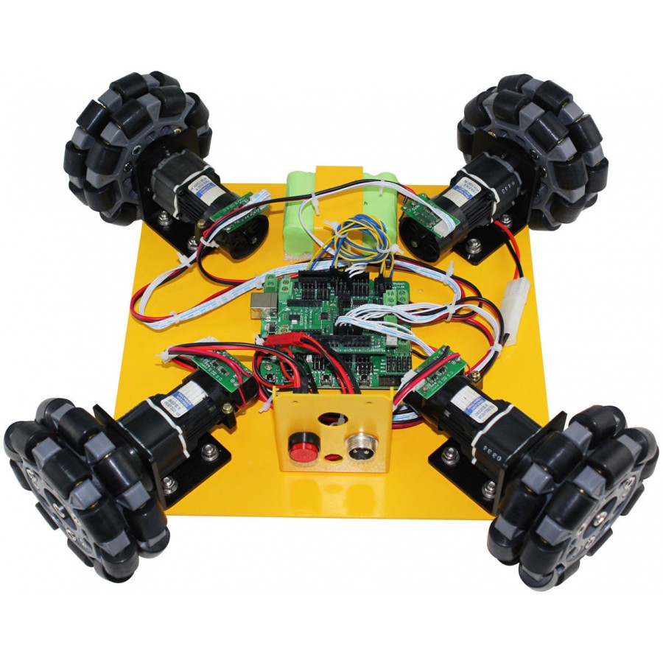
Robot Model 2 Omni-drive
Inputs
v -> velocity
ω -> heading
Desired information: Velocity of each wheel
Calculation
Input vector = [v * cos(ω), v * sin(ω)]
Rotate input vector 45 degrees
Dot multiply vector times rotation matrix of 45 degrees
X of input vector is velocity for wheels 1 & 3
Y of input vector is velocity for wheels 2 & 4
Example: https://www.instagram.com/p/BYxLeTlh8R6/?taken-by=zachallen417

Slide 6
Demonstration

